Slide 1
Bayesian Theorem
UNIT-III

Slide 2

Introduction

Slide 3


Slide 4


Slide 5
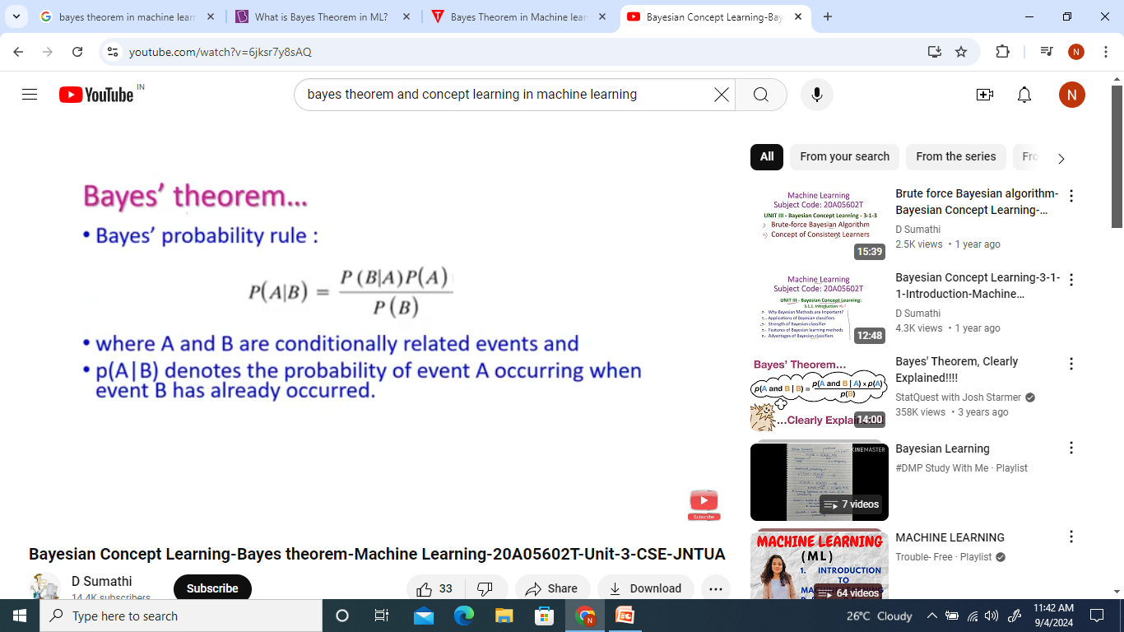
Baye’s theorem

Slide 6
Bayes Theorem
Bayes' Theorem is a mathematical formula used to determine the conditional probability of an event based on prior knowledge and new evidence.
It adjusts probabilities when new information comes in and helps make better decisions in uncertain situations.

Slide 7

Bayes Equation
P(A) and P(B) are the probabilities of events A and B; also, P(B) is never equal to zero.
P(A|B) is the probability of event A when event B happens,
P(B|A) is the probability of event B when A happens.

Slide 8
Priori Probability
Priori Probability P(E_{i}) is the initial probability of an event occurring before any new data is taken into account.
It reflects existing knowledge or assumptions about the event.
Example: The probability of a person having a disease before taking a test.

Slide 9
Posterior Probability
Posterior probability (P(Ei∣A) is the updated probability of an event after considering new information.
It is derived using the Bayes Theorem.
Example: The probability of having a disease given a positive test result.

Slide 10
Conditional Probability
The probability of an event A based on the occurrence of another event B is termed conditional Probability.
It is denoted as P(A|B) and represents the probability of A when event B has already happened.

Slide 11
Joint Probability
When the probability of two or more events occurring together and at the same time is measured, it is marked as Joint Probability.
For two events A and B, it is denoted by joint probability is denoted as P(A∩B).

Slide 12
Key Applications are:
AI & Machine Learning → Used in Naïve Bayes classifiers to predict outcomes.
Medical Testing → Finding the real probability of having a disease after a positive test.
Spam Filters → Checking if an email is spam based on keywords.
Weather Prediction → Updating the chance of rain based on new data.

Slide 13


Slide 14


Slide 15


Slide 16


Slide 17
Prior Distribution:
Represents existing knowledge or beliefs about a parameter before any new data is observed.
Likelihood:
The probability of observing the given data, assuming a particular value for the parameter.
Posterior Distribution:
The updated probability distribution of the parameter after considering the observed data. It is calculated using Baye‘s Theorem, which combines the prior and the likelihood

Slide 18


Slide 19
The Bayes optimal classifier is a probabilistic model that makes the most probable prediction for a new example, given the training dataset.
This model is also referred to as the Bayes optimal learner, the Bayes classifier, Bayes optimal decision boundary, or the Bayes optimal discriminant function.

Slide 20
Bayes optimal classifier
Bayes Classifier: Probabilistic model that makes the most probable prediction for new examples.
Specifically, the Bayes optimal classifier answers the question:
What is the most probable classification of the new instance given the training data?

Slide 21
This is different from the MAP framework that seeks the most probable hypothesis (model). Instead, we are interested in making a specific prediction.
In general, the most probable classification of the new instance is obtained by combining the predictions of all hypotheses, weighted by their posterior probabilities.

Slide 22
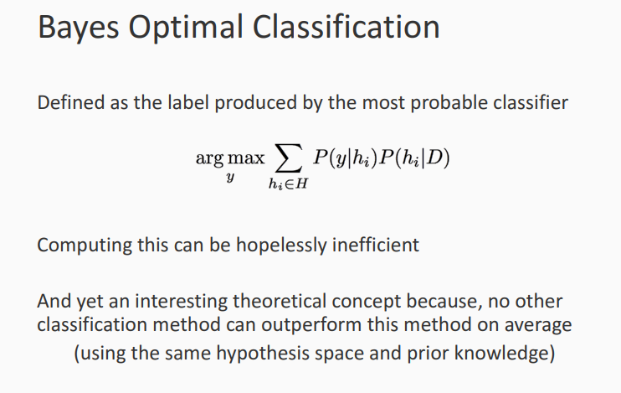

Slide 23
Naïve Bayesian classiﬁer.
Naïve Bayesian classiﬁer.
Let D be a training set of tuples and their associated class labels. Each tuple is represented by an n-dimensional attribute vector, X=(x1, x2,..., xn), depicting n measurements made on the tuple from n attributes, respectively, A1, A2,..., An.
There are m classes, C1, C2,..., Cm. Given a tuple, X, the classiﬁer will predict that X belongs to the class having the highest posterior probability, conditioned on X.
That is, the naïve Bayesian classiﬁer predicts that tuple X belongs to the class Ci if and only if

Slide 24
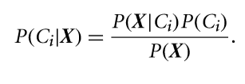
Naїve Bayesian Classiﬁcation
Thus, we maximize P(Ci|X). The class Ci for which P(Ci|X) is maximized is called the maximum posteriori hypothesis.

Slide 25
Naїve Bayesian Classiﬁcation
3. As P(X) is constant for all classes, only P(X|Ci)P(Ci) needs to be maximized.
If the class prior probabilities are not known, then it is commonly assumed that the classes are equally likely, that is, P(C1)=P(C2)=···=P(Cm), and we would therefore maximize P(X|Ci).
Otherwise, we maximize P(X|Ci)P(Ci).
Class prior probabilities may be estimated by P(Ci)=|Ci,D|/|D|

Slide 26
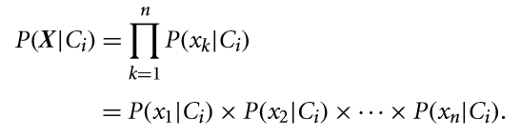
Naїve Bayesian Classiﬁcation
4. Given data sets with many attributes, it would be extremely computationally expensive to compute P(X|Ci).
To reduce computation in evaluating P(X|Ci), the na¨ıve assumption of class-conditional independence is made.
This presumes that the attributes’ values are conditionally independent of one another, given the class label of the tuple

Slide 27
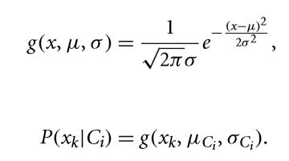
Naїve Bayesian Classiﬁcation
For each attribute, we look at whether the attribute is categorical or continuous-valued.
If Ak is categorical, then P(xk|Ci) is the number of tuples of class Ci in D having the value xk for Ak, divided by |Ci,D|, the number of tuples of class Ci in D.
If Ak is continuous-valued, is typically assumed to have a Gaussian distribution with a mean µ and standard deviation σ, deﬁned by

Slide 28
Naїve Bayesian Classiﬁcation
5. To predict the class label of X, P(X|Ci)P(Ci) is evaluated for each class Ci. The classiﬁer predicts that the class label of tuple X is the class Ci if and only if
Under certain assumptions, it can be shown that many neural network and curve-ﬁtting algorithms output the maximum posteriori hypothesis, as does the na¨ıve Bayesian classiﬁer

Slide 29
Predict a class label using Naїve Bayesian Classiﬁcation
Let C1 correspond to the class buys_computer = yes and C2 correspond to buys_computer = no.
The tuple we wish to classify is
X = (age = youth, income = medium, student = yes, credit rating = fair)
We need to maximize P(X|Ci)P(Ci), for i=1, 2.

Slide 30
Naїve Bayesian Classiﬁcation
The prior probability of each class,
P(buys computer=yes)=9/14=0.643
P(buys computer=no) =5/14=0.357

Slide 31
Naїve Bayesian Classiﬁcation
To compute P(X|Ci), for i=1,2, we compute the following conditional probabilities
P(age=youth|buys computer=yes) =2/9=0.222
P(age=youth|buys computer=no) =3/5=0.600
P(income=medium|buys computer=yes)=4/9=0.444
P(income=medium|buys computer=no) =2/5=0.400
P(student=yes|buys computer=yes) =6/9=0.667
P(student=yes|buys computer=no) =1/5=0.200
P(credit rating=fair|buys computer=yes)=6/9=0.667
P(credit rating=fair|buys computer=no) =2/5=0.400

Slide 32
Naїve Bayesian Classiﬁcation
P(X|buys computer=yes) = P(age=youth|buys computer=yes) × P(income=medium|buys computer=yes) × P(student=yes|buys computer=yes) × P(credit rating=fair|buys computer=yes)
= 0.222 × 0.444 × 0.667 × 0.667 = 0.044.
Similarly, P(X|buys_computer = no) = 0.600×0.400×0.200×0.400=0.019.
To ﬁnd the class, Ci, that maximizes P(X|Ci)P(Ci), we compute
P(X|buys_computer = yes) P(buys_computer=yes)=0.044×0.643=0.028
P(X|buys_computer = no) P(buys_computer=no)=0.019×0.357=0.007
Therefore, the na¨ıve Bayesian classiﬁer predicts buys_computer = yes for tuple X.

Slide 33
Bayesian Belief Network
Bayesian Belief Network is a graphical representation of different probabilistic relationships among random variables in a particular set.
It is a classifier with no dependency on attributes i.e it is condition independent.

Slide 34
Bayesian belief network
The Bayesian Belief Network (BBN) is a crucial framework technology that deals with probabilistic events to resolve an issue that has any given uncertainty.
A probabilistic graphical model visually presents variables and their unique dependencies through a directed graph with no directed cycles (DAG).

Slide 35

Bayesian Belief Network Example

Slide 36
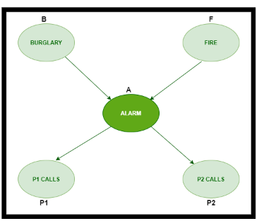
BBN

Slide 37

BBN Example

Slide 38
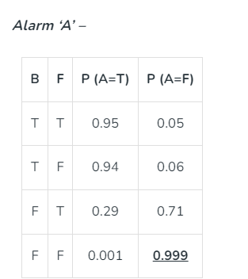
Probability of an alarm

Slide 39


Probability of P1 and P2

Slide 40
Problem
What is the probability that the alarm has sounded but neither a burglary nor fire/earthquake has occurred and both P1 and P2 call ….?

Slide 41
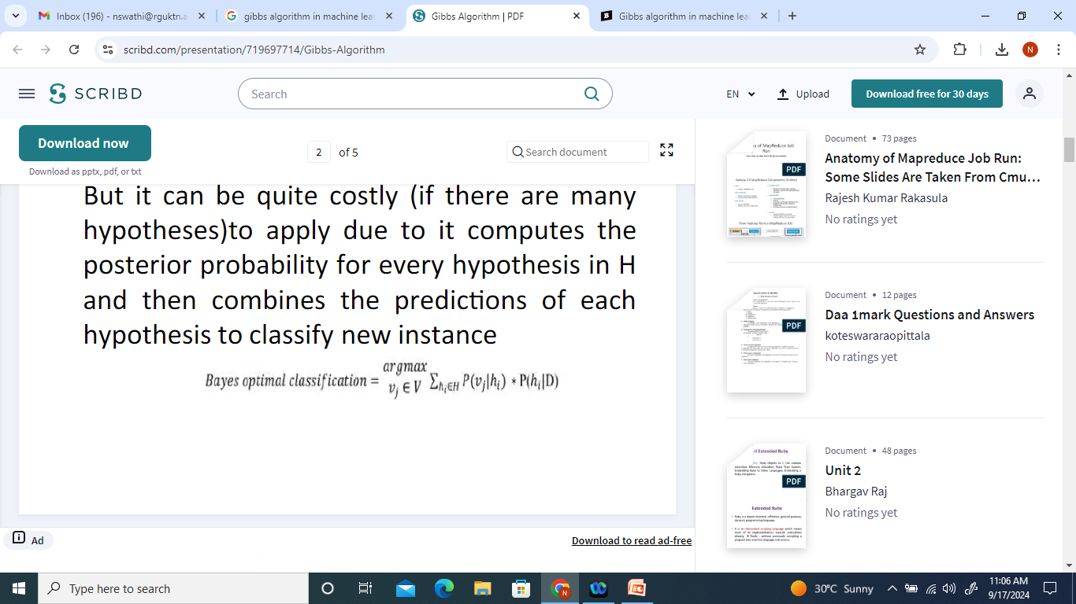
Gibbs Algorithm
Bayes optimal classifier provides best optimal.
But it can be quite costly (if there are many hypothesis) to apply due to it computes the posterior probability for every hypothesis in H and then combines the predictions of each hypothesis to classify new instance.

Slide 42
Gibbs algorithm is an alternative to bayes optimal classifier
It provides less optimal defined as follows:
1. choose a hypothesis h from H at random, according to the posterior probability distribution over H.
2.Use h to predict the classification of the next instance X.

Slide 43
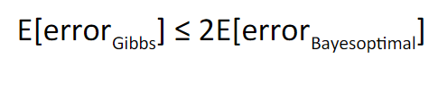
Limitation: The expected value of the error of Gibbs algorithm is at worst twice the expected value of the error of the Bayes optimal classifier.

Slide 44
Minimum description length (MDL)
Minimum description length (MDL), which originated from algorithmic coding theory in computer science, regards both model and data as codes.
Any data set can be appropriately encoded with the help of a model, and that the more we compress the data by extracting redundancy from it, the more we uncover underlying regularities in the data.

Slide 45
Thus, code length is directly related to the generalization capability of the model, where the model that provides the shortest description of the data should be chosen.
Formally, the total description length of a model is given by
MDL=L(data|model)+L(model)

Slide 46
EM Algorithm
The Expectation-Maximization (EM) algorithm is an iterative optimization method that combines different unsupervised machine learning algorithms to find maximum likelihood or maximum posterior estimates of parameters in statistical models that involve unobserved latent variables.
The EM algorithm is commonly used for latent variable models and can handle missing data. It consists of an estimation step (E-step) and a maximization step (M-step), forming an iterative process to improve model fit.

Slide 47
Latent variable
A latent variable is a hidden, unobservable characteristic or feature that influences the observable data but cannot be measured directly.
Models infer these latent variables from observed data to uncover underlying patterns and create more abstract, condensed representations of information.

Slide 48
In the E step, the algorithm computes the latent variables i.e. expectation of the log-likelihood using the current parameter estimates.
In the M step, the algorithm determines the parameters that maximize the expected log-likelihood obtained in the E step, and corresponding model parameters are updated based on the estimated latent variables.

Slide 49
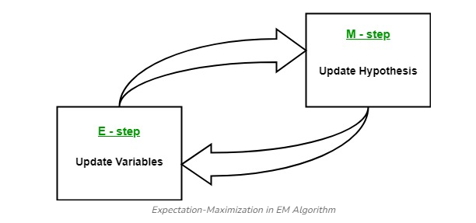
EM Algorithm

Slide 50
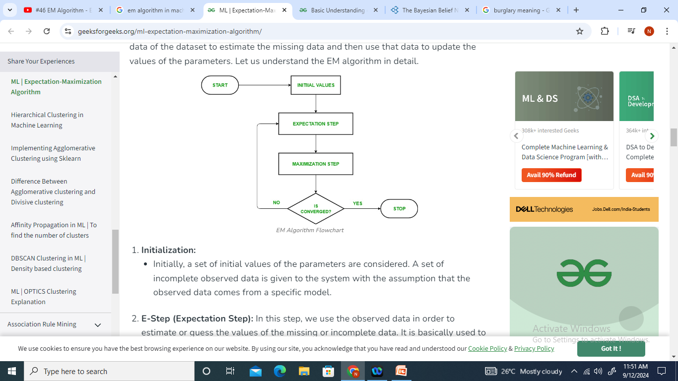
EM Algorithm

Slide 51
Algorithm in steps
Initialization:
Initially, a set of initial values of the parameters are considered.
A set of incomplete observed data is given to the system with the assumption that the observed data comes from a specific model.

Slide 52
E-Step (Expectation Step): In this step, we use the observed data in order to estimate or guess the values of the missing or incomplete data. It is basically used to update the variables.
Compute the posterior probability or responsibility of each latent variable given the observed data and current parameter estimates.
Estimate the missing or incomplete data values using the current parameter estimates.
Compute the log-likelihood of the observed data based on the current parameter estimates and estimated missing data.

Slide 53
M-step (Maximization Step): In this step, we use the complete data generated in the preceding “Expectation” – step in order to update the values of the parameters. It is basically used to update the hypothesis.
Update the parameters of the model by maximizing the expected complete data log-likelihood obtained from the E-step.
This typically involves solving optimization problems to find the parameter values that maximize the log-likelihood.
The specific optimization technique used depends on the nature of the problem and the model being used.

Slide 54
Convergence: In this step, it is checked whether the values are converging or not, if yes, then stop otherwise repeat step-2 and step-3 i.e. “Expectation” – step and “Maximization” – step until the convergence occurs.
Check for convergence by comparing the change in log-likelihood or the parameter values between iterations.
If the change is below a predefined threshold, stop and consider the algorithm converged.
Otherwise, go back to the E-step and repeat the process until convergence is achieved.

Slide 55
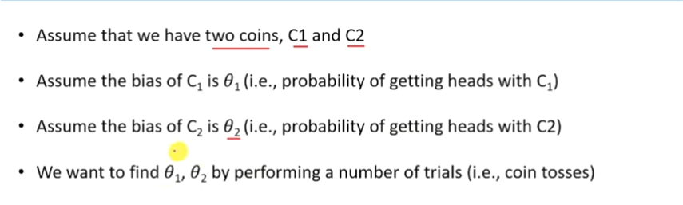

Slide 56
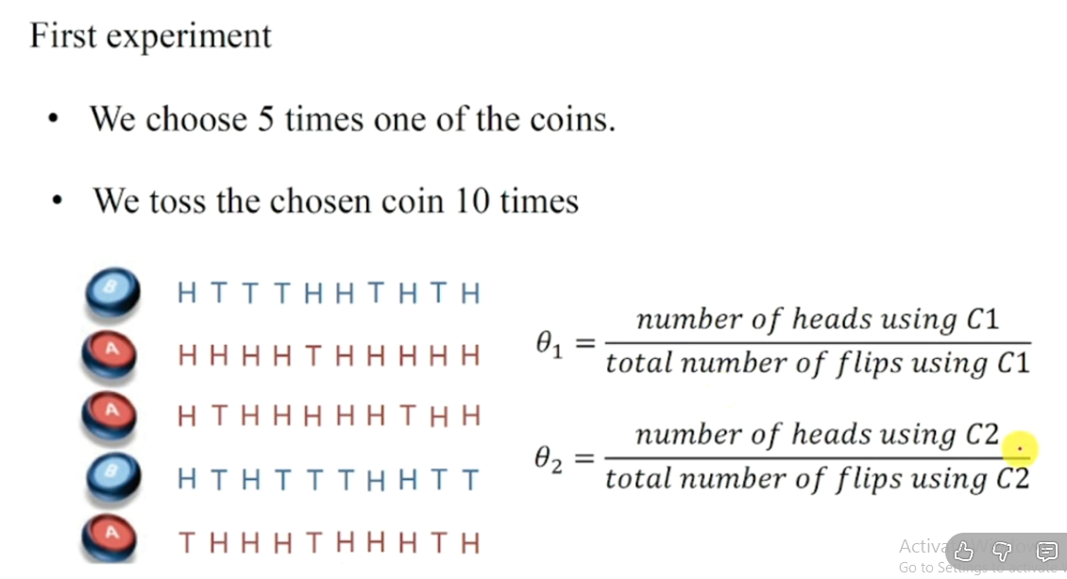

Slide 57
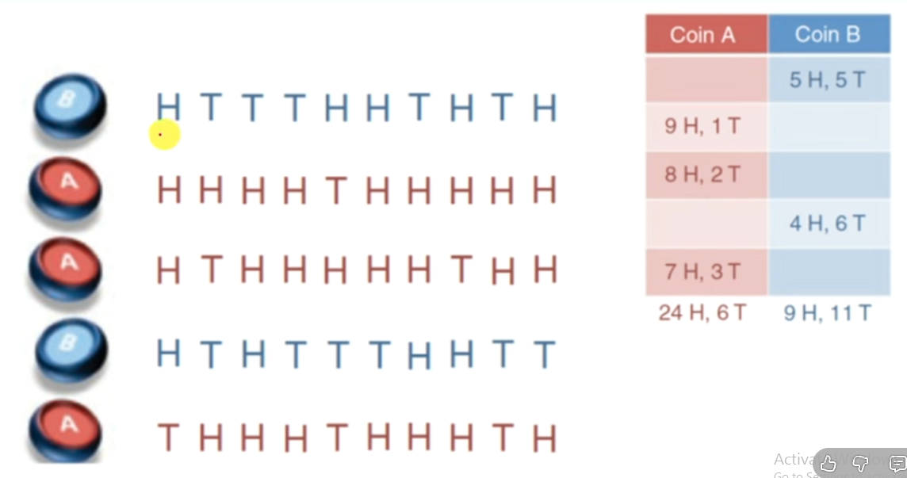

Slide 58
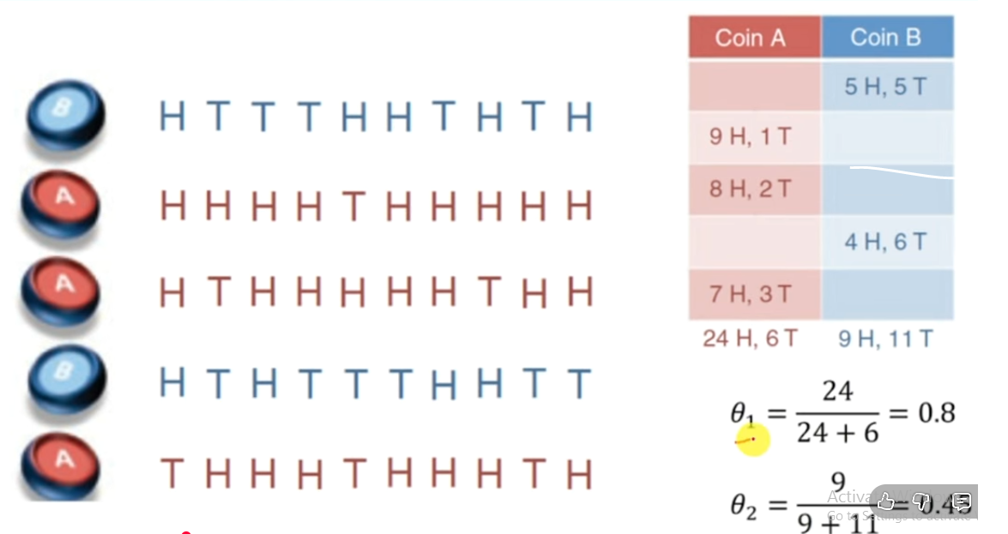

Slide 59
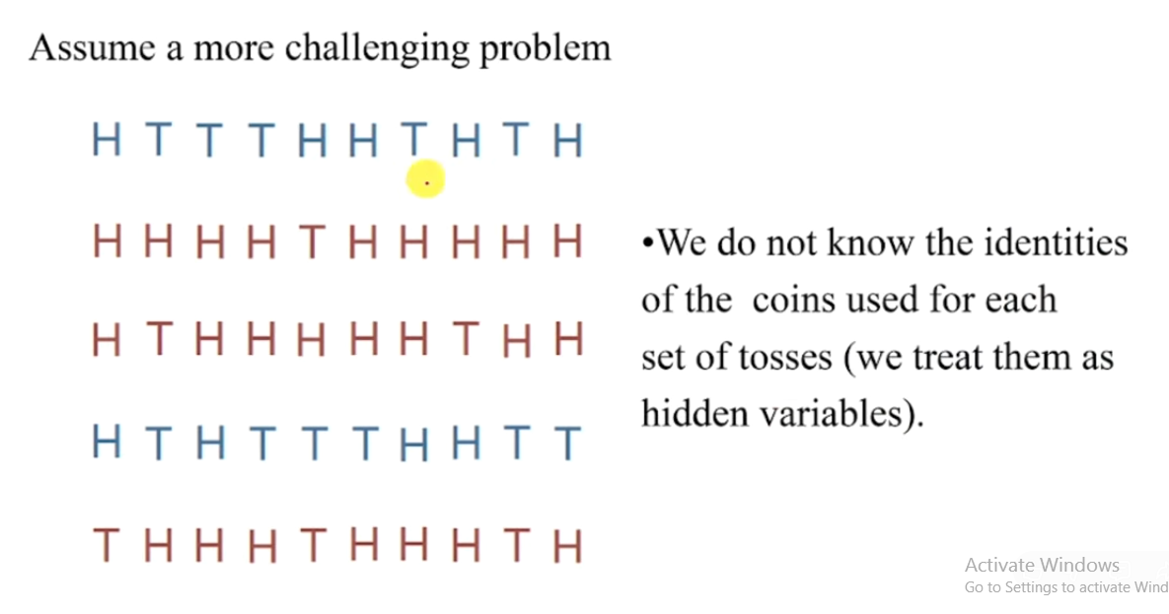

Slide 60
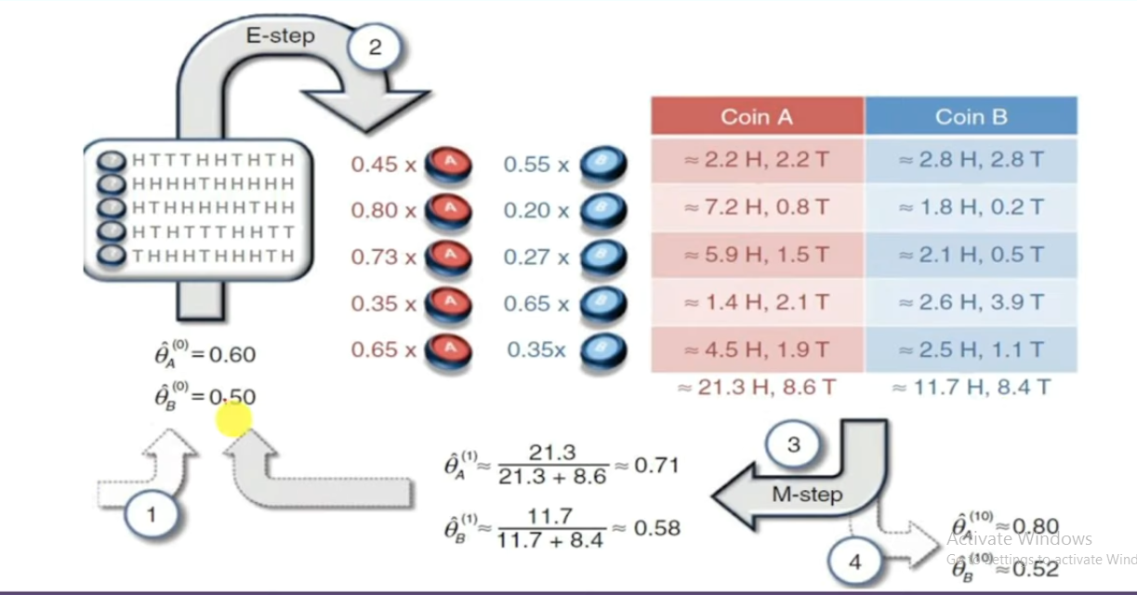

Slide 61
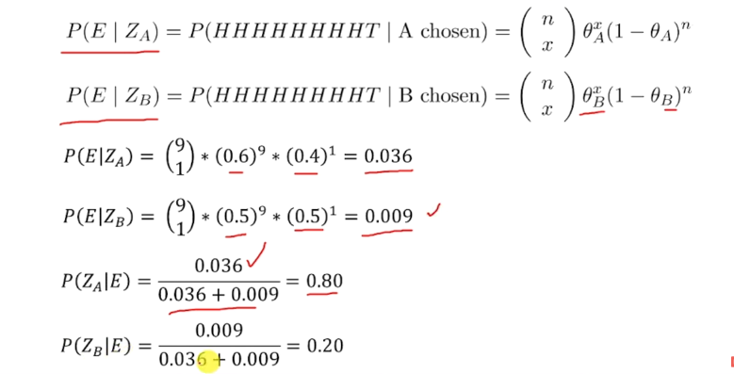

Slide 62
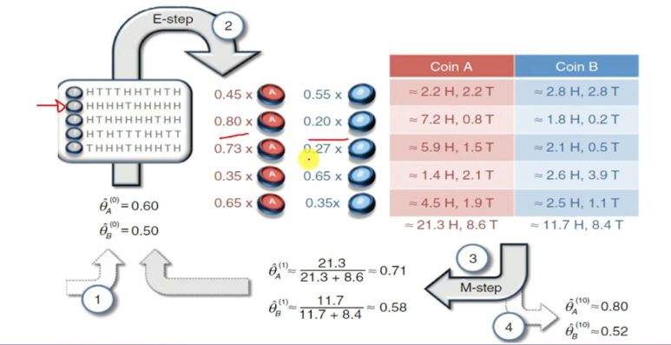

Slide 63
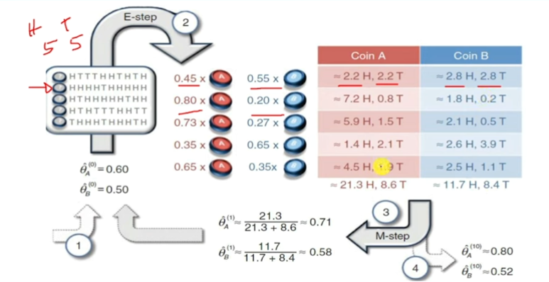

Slide 64
